Slide 1


Docker + Microsoft – investing in the future of your applications
Taylor Brown
@taylorb_msft
Steve Lasker
@stevelasker

Slide 2

Where can I get these slides/demos?
Slides:
https://docs.com/taylorb/
Demos: https://github.com/SteveLasker/Visitors

Slide 3
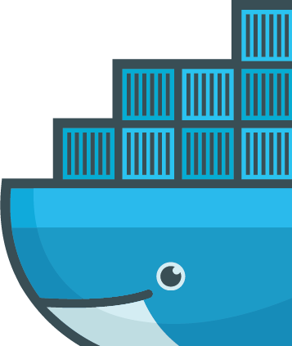
Microsoft Container Technologies
Introduction to Containers
What is a Container
Microsoft Container technologies
Lift & shift and modernize apps demo
Windows Server Containers
Azure Container Service
App Service, Service Fabric & Operations Management Suite

Slide 4




The cloud has changed expectations
Availability
100% uptime
Hyper-scale
From startup to enterprise
Agility
Deliver just in time speed
http://www.gettyimages.com/detail/photo/cloud-computing-and-communications-technology-royalty-free-image/145671614
Notes:
Change happens every day. New Acquisitions, New Industries, New Opportunities
The early bird gets the worm

Slide 5

Containers deliver speed, flexibility, and savings
Availability
Hyper-scale
Agility
62%
Report reduction in MTTR
41%
Move workloads across private/public clouds
13X
More software releases
10X
Cost reduction in maintaining existing applications
65%
Reduction in developer onboarding time
Eliminate
“Works on my machine” issues
State of App development Survey: Q1 2016, Cornell University case study
Notes:
The Docker CaaS platform delivers these benefits for organizations and is already proven by the thousands of organizations who embarked on the Docker journey starting in 2013
Agility – The speed and simplicity of Docker is what originally drew developers to Docker. They were fundamentally able to ship more software faster. This fundamentally changed the way in which companies could innovate
- ING went from shipping once every 9 months to shipping over 1,500 times a year by adoption Docker and DevOps
- CapitalOne was able to use Docker to transform how they use data to empower their data scientists and business decisions.
Portability – Just by the nature of the Docker technology, these developers realized they could easily move that containerized app from dev to test and ultimately to prod without any issue. No more finger pointing about why the app that worked fine in dev doesn’t work in prod. Having the app and dependencies packaged together made the container a self contained and independent unit. And beyond that, teams realized they could also move these apps across data centers and clouds – giving them a level of freedom and leverage not possible before. No more lock-in.
The combination of agility and portability led to the #1 most popular use case for Docker – Continuous Integration. But that’s only half the value. To realize the full value of Docker, these apps need to move to production and new requirements around manageability, security and monitoring are required to enforce SLAs.
Control – The Docker platform is the only solution that provides Agility AND Portability AND Control.
Docker standardizes your application environment, with native tooling to manage the infrastructure and applications. And we provide you the levers so YOU can decide how much control and freedom is appropriate for YOUR business. We don’t prescribe that for you. Our tools help unify your heterogeneous infrastructure, languages and systems.

Slide 6
What is a
Container?

Slide 7
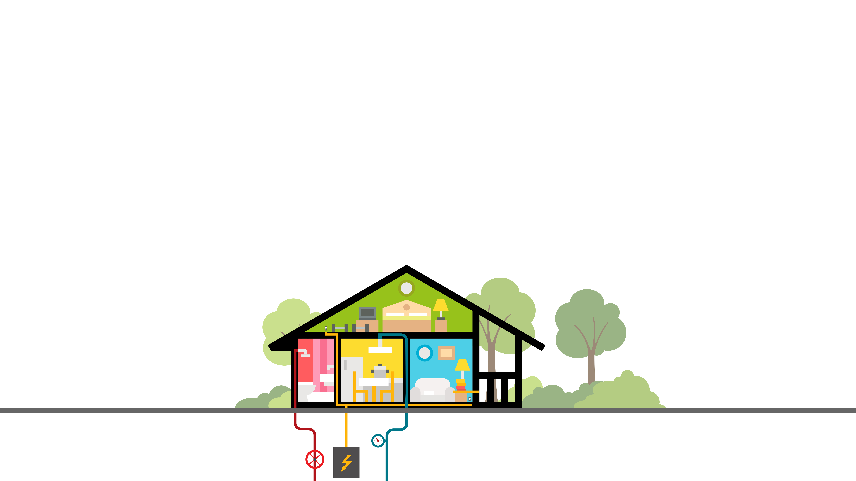
VM vs Container
Notes:
Helpful to reflect on history a bit. Apps install on OS, OS installs on hardware.

Slide 8
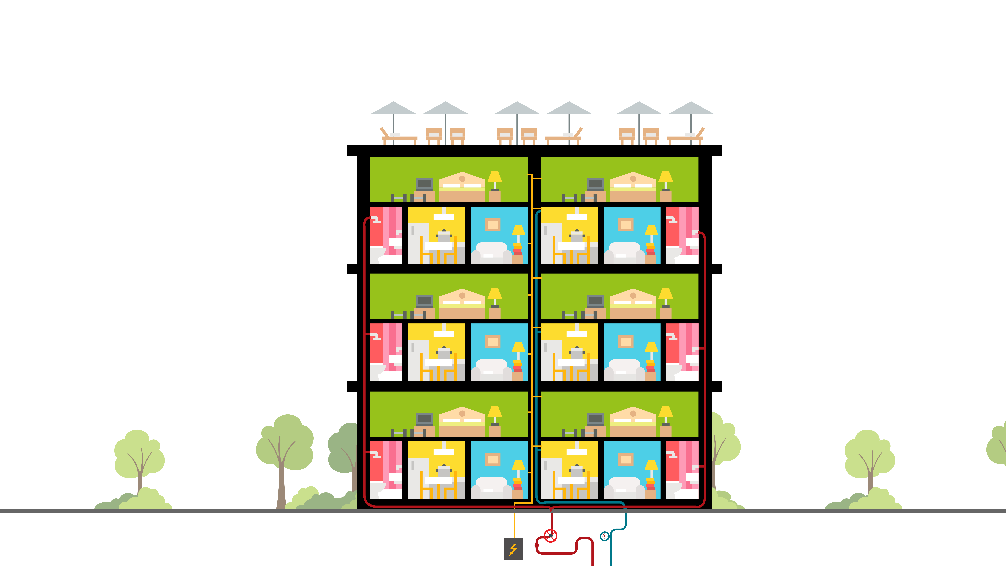
VM vs Container
Notes:
Helpful to reflect on history a bit. Apps install on OS, OS installs on hardware.

Slide 9
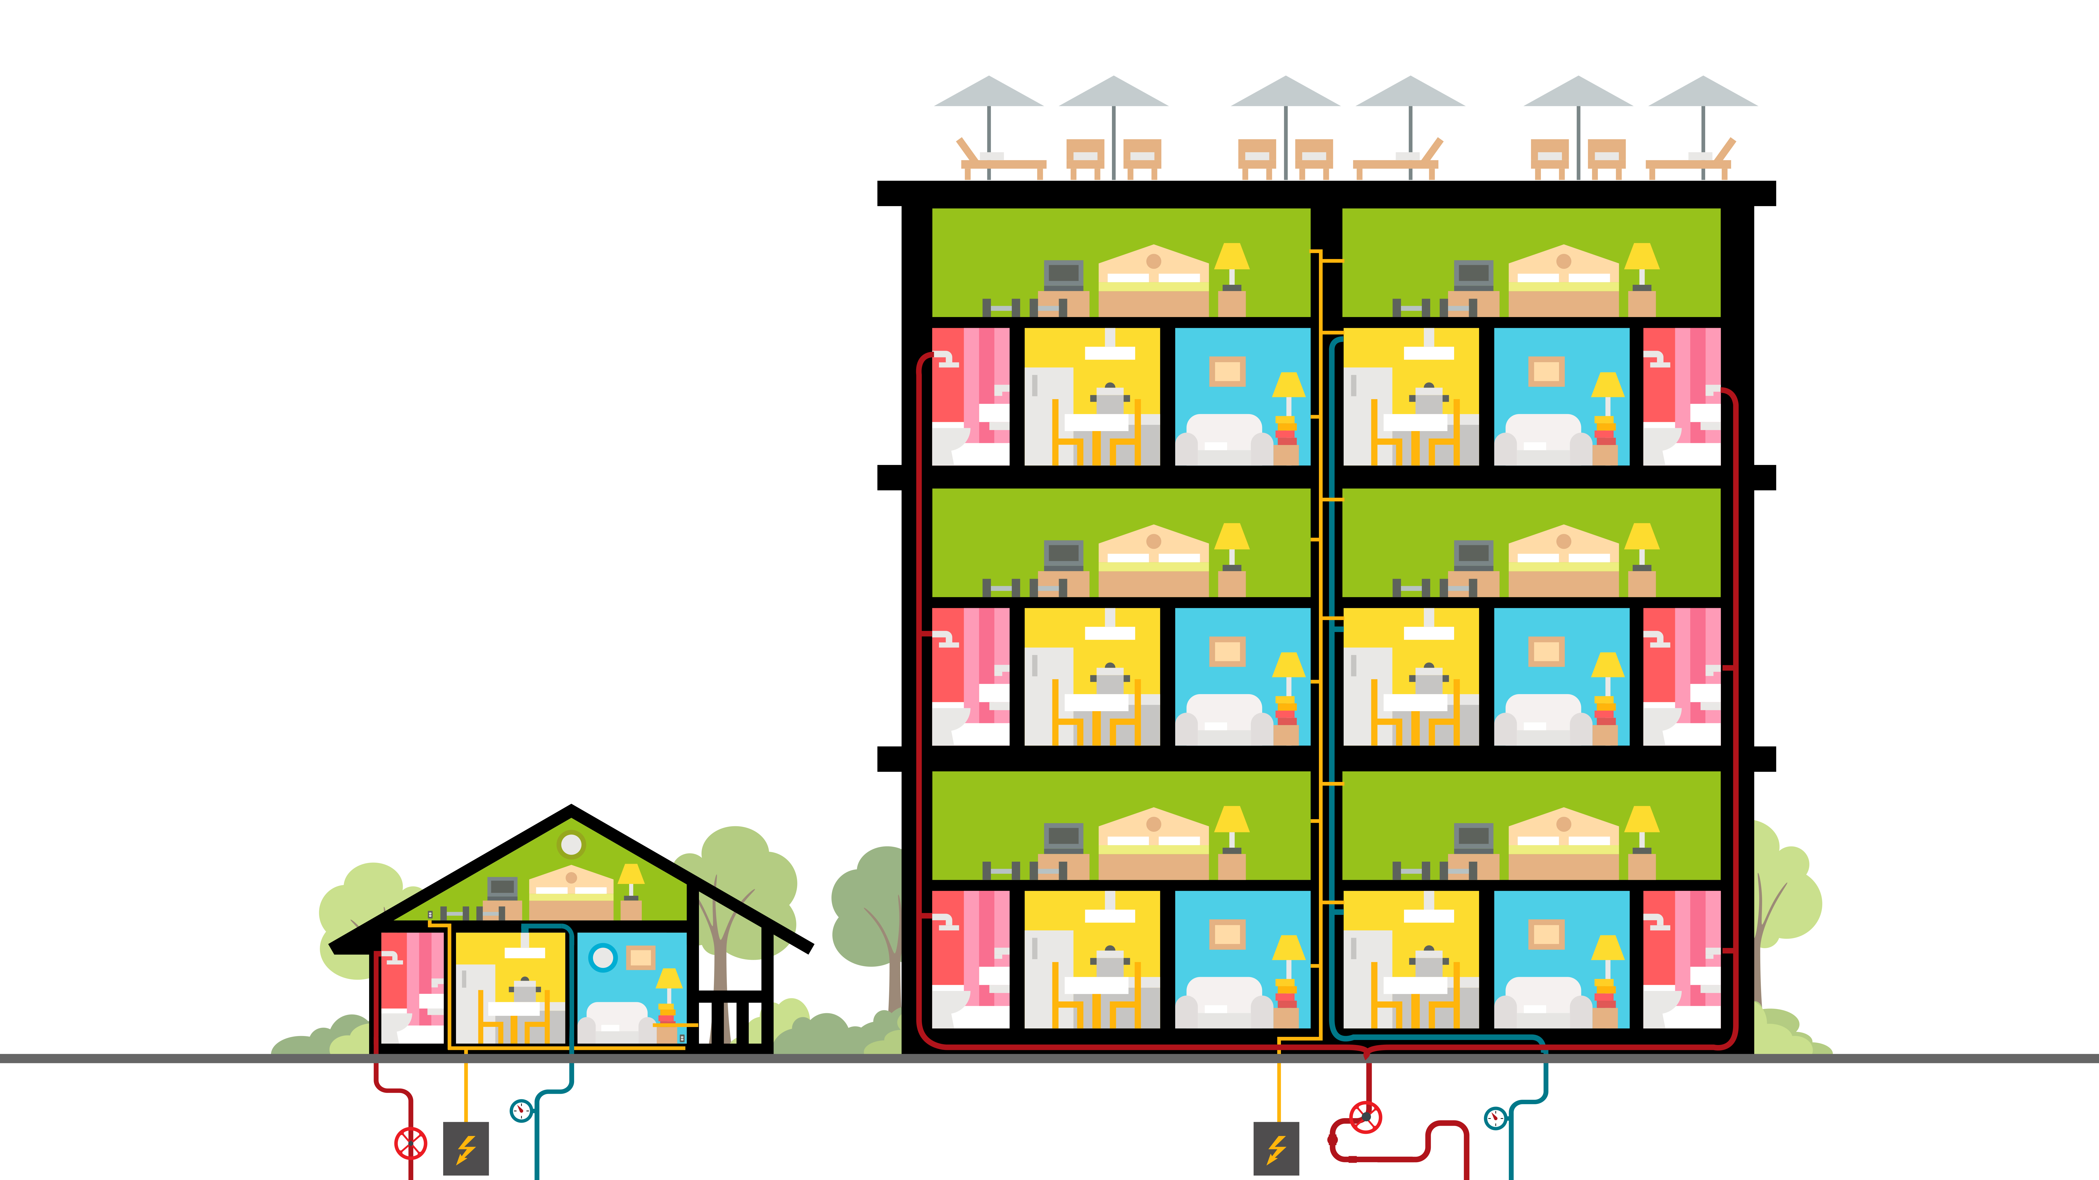
VM vs Container
Notes:
Helpful to reflect on history a bit. Apps install on OS, OS installs on hardware.

Slide 10
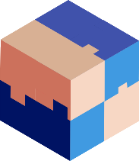

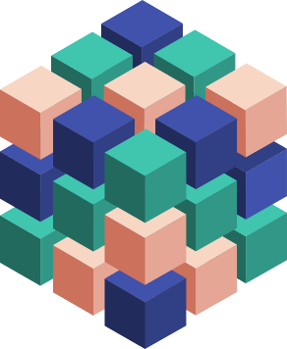
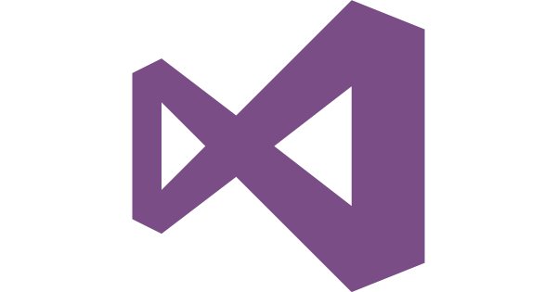
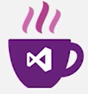
Microsoft & Docker – better together
Any OS
Arsenal
Linux Containers, Windows Server Containers, and Hyper-V Issolation
Run on-premises, on Azure, on other public clouds, service provider clouds
Monoliths, Microservices, and other app types
Development frameworks and environments supported: Microsoft and ecosystem
Linux
Windows
Anywhere
On-premises
Hosted
Any app
Monolith
Microservice
Any language
.NET
Java

Slide 11
Microsoft Container Technologies
Notes:
Optional:

Slide 12

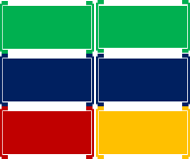
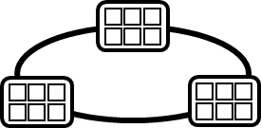
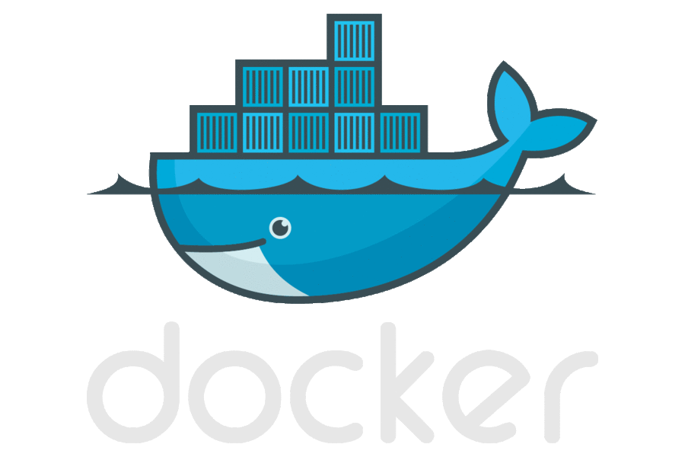



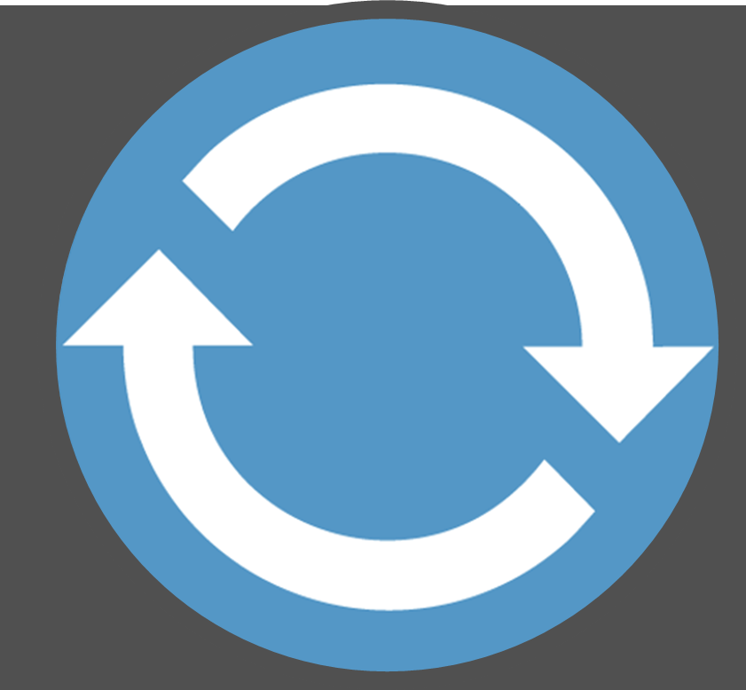
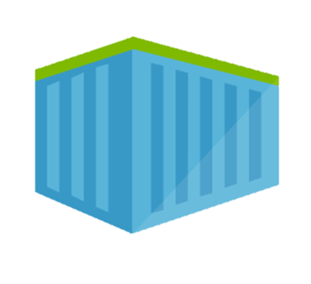
Containerized workflow
Container Service
2.
3.
4.
5.
Run, Manage
Service Fabric
Source Code Control
(SCC)
Build/CI,
Integrate,
Test
CD, Deploy
App Services
Production
environments
Common soon
Azure Container Registry
…
Push
code
…
Inner-Loop
6.
…
1.
Run
Azure Monitoring
Code
Validate
Debug
Outer-Loop
Notes:
When we look at the container continuous worfklows, we see containers and registries are a key concept.
We start with what we call the inner loop. Which is everything you do before you commit code.
From the beginning of your development cycle, you’re building and running your code in containers.
We pull base images from a container registry. Either Docker Hub, or perhaps our private corporate registry.
As we’re happy with our code, we commit the code to a source code repository.
The build system takes our code, a dockerfile that describes the build system and builds the collection of images I need for deployment
The images are pushed to our private registry, with the environment configurations extracted from the image.
When deployment happens, we pull images, add the environment information and push it out to various environments.
In Azure, we have many different container hosting offerings.
From Azure Container Service, which hosts the best of breed open source orchestrators
To Service Fabric, which can host guest containers
Or, Azure Batch, App Services for single container workloads that can scale.
And Azure continues to expand it’s container hosts as containers are becoming the unit of deployment.

Slide 13

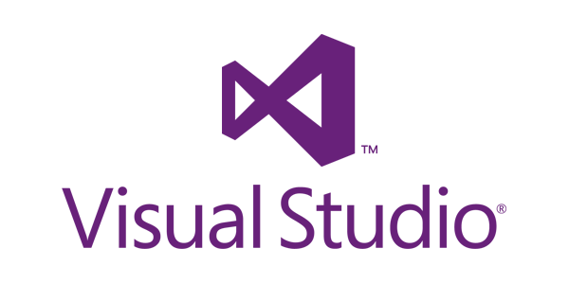
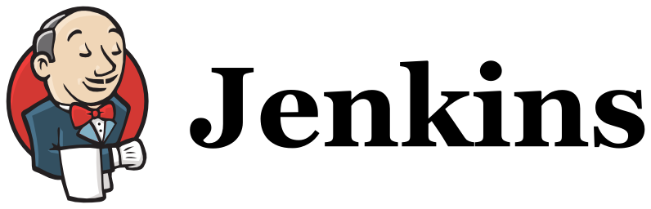
Microsoft Container Integrations
Language/ Framework
.NET
.NET Core
Node.js
GO
Java
Full FX
Core
Dev Tools
VS Code
IntelliJ
Build System
VSTS CI/CD
Target OS
Windows Server
Containers
Nano Server
Containers
Linux
Containers
Container Registry
Azure Container Registry
Secret Management
VSTS
Azure KeyVault, Hashicorp Vault
Container Hosting
App Services with Containers
ACS – Docker
ACS – Kubernetes
Service Fabric
ACS –DC/OS

Slide 14
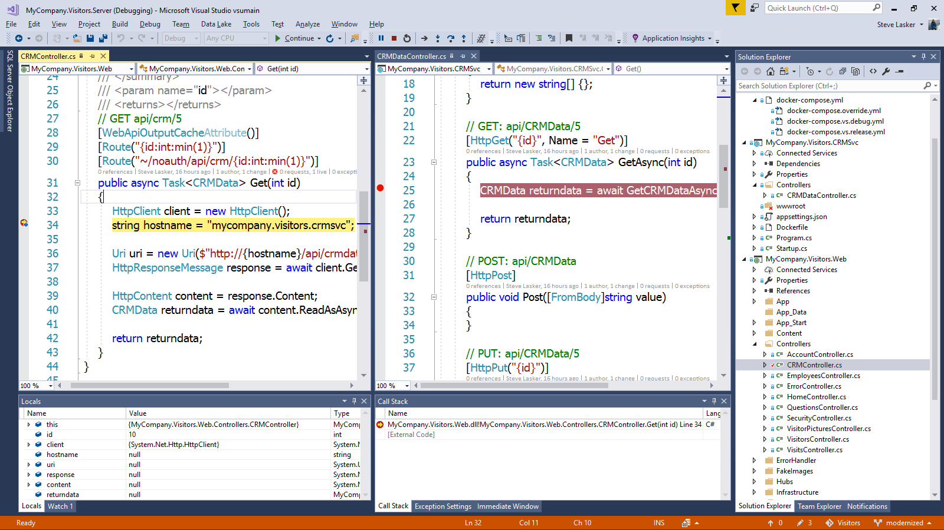
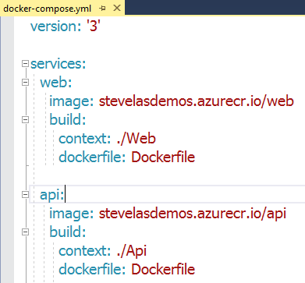
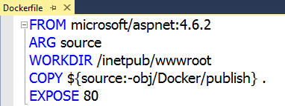
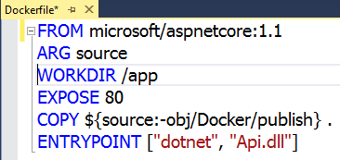
Visual Studio 2017 Container tools
Run, debug, test web, and console apps in Docker Containers
.NET FX w/Windows Server, .NET Core with Nano Server, and Linux
Breakpoint debugging
Edit & refresh of code
Scaffolds Docker assets
Dockerfile, docker-compose.yml

Slide 15
Lift & shift and modernize apps demo
Notes:
Optional:

Slide 16
SQL Server in Docker
SQL
Microsoft’s flagship database product, also available in Docker
Industry leader in
Mission Critical OLTP
Most secure database
Highest performing data warehouse
Best TCO
Most consistent experience
Best price/ performance
7 years in a row least vulnerable
#1 performance
1/12th the cost of Oracle
On-premises to cloud
SQL Server
SQL Server
SQL Server
1/12
#1
#2
#3
Oracle is #5
TPC-E
TPC-H
Everything built-in
SQL Server
Oracle
MySQL2
SAP HANA
Notes:
Choice of most popular container orchestrators: Azure Container Service makes it simpler for you to create, configure, and manage a cluster of virtual machines that are preconfigured to run containerized applications. It uses an optimized configuration of popular open-source scheduling and orchestration tools. This enables you to use your existing skills, or draw upon a large and growing body of community expertise, to deploy and manage container-based applications on Microsoft Azure. Choose the tools and solution that best suits your needs for Docker container orchestration and scale operations. Use the Mesos-based DC/OS, Kubernetes, or use Docker Swarm and Compose for a pure Docker experience.
Simplest way to deploy containers on Azure: Azure Container Service provides rapid deployment of popular open-source container clustering and orchestration solutions. By using Azure Container Service, you can deploy DC/OS, Kubernetes, and Docker Swarm clusters with Azure Resource Manager templates or the Azure portal.
Few clicks to enterprise grade container solution: Azure Container Service optimizes the configuration of popular open source tools and technologies specifically for Azure. Work with the open source tools you know. Because we expose the standard API endpoints for our orchestration engine, you know the most popular tools will be compatible with Azure Container Service and, in most cases, will work out of the box—including visualizers, monitoring, continuous integration, command line tools, and even future tools as they become available.

Slide 17
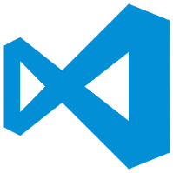
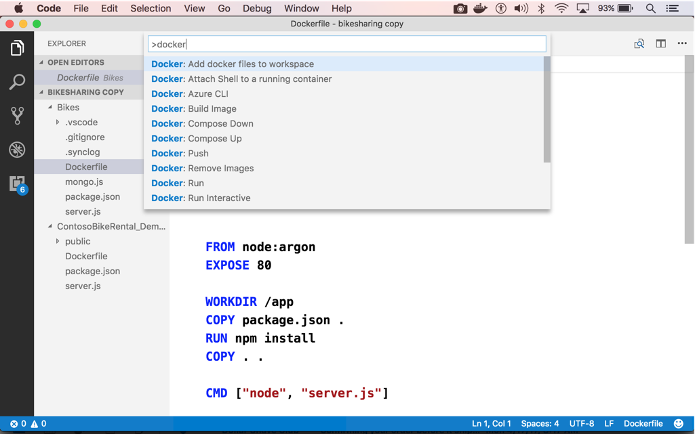
Visual Studio code
OS X, Linux, Windows
Node, Python, Go, .NET Core
Git SCC integration
Extensible platform
Docker Asset Editing – extension
aka.ms/VSCode
aka.ms/Dock`erToolsForVSCode

Slide 18
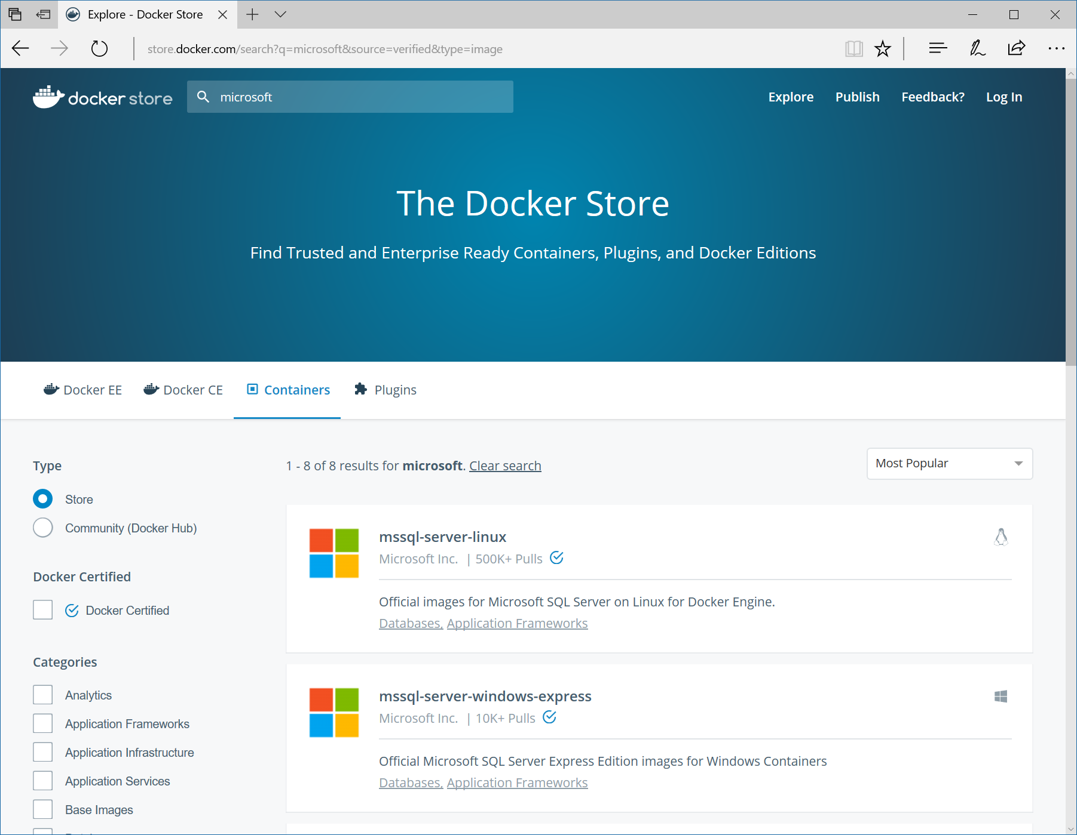
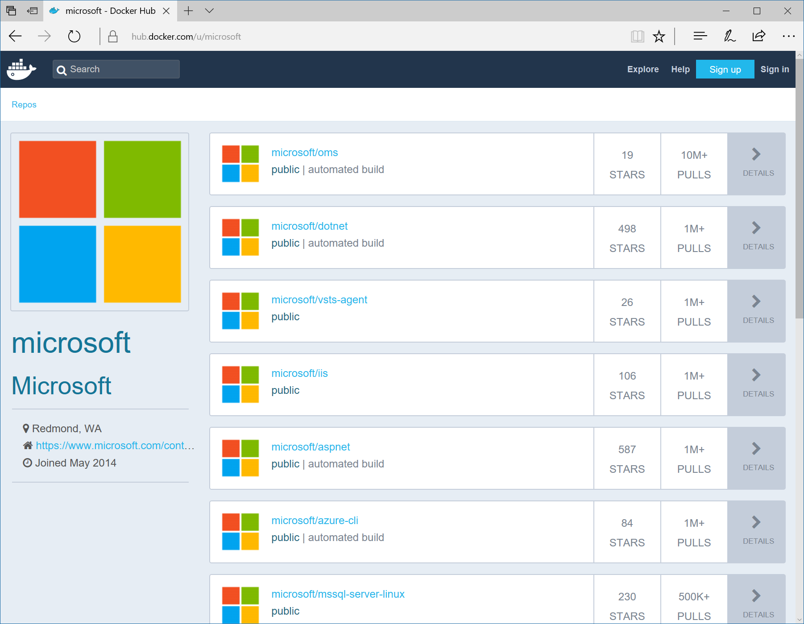
Maintained images by Microsoft
https://store.docker.com/
https://hub.docker.com/u/microsoft/

Slide 19
Windows Server
Containers
Notes:
Optional:

Slide 20
Windows Containers
Host User Mode
Container Runtime
Docker Engine
containerD
Windows Kernel

Slide 21
Windows Containers
Host User Mode
Container Runtime
Docker Engine
Windows Server Container
containerD
App
Windows Kernel
Hyper-V Hypervisor

Slide 22
Windows Containers
Host User Mode
Container Runtime
Docker Engine
Windows Server Container
Windows Server Container
containerD
App
App
Windows Kernel
Hyper-V Hypervisor

Slide 23
Windows Containers
Host User Mode
Hyper-V Isolation
Container Runtime
Virtual Machine Optimized for Container
Docker Engine
Windows Server Container
Windows Server Container
containerD
App
App
Windows Kernel
Windows Kernel
Hyper-V Hypervisor

Slide 24
Windows Containers
New
Host User Mode
Hyper-V Isolation
Hyper-V Isolation
Container Runtime
Virtual Machine Optimized for Container
Virtual Machine Optimized for Container
Docker Engine
Windows Server Container
Windows Server Container
Linux
Container
containerD
App
App
App
Windows Kernel
Windows Kernel
Linux Kernel
Hyper-V Hypervisor

Slide 25
Container operating system environments
Nano Server
Server Core
Highly optimized
Born-in-the-cloud applications
Highly compatible
Traditional applications
Windows Server
Notes:
Windows Server and Hyper-V Containers will both take advantage of the smaller installation options for Windows Server: Server Core and (new in Windows Server 2016) Nano Server. Nano Server is a highly-optimized, headless deployment option for Windows Server that runs at a fraction of the Windows Server footprint and is ideal for cloud services. Containers running Server Core are available now with Windows Server 2016 Technical Preview 3.

Slide 26
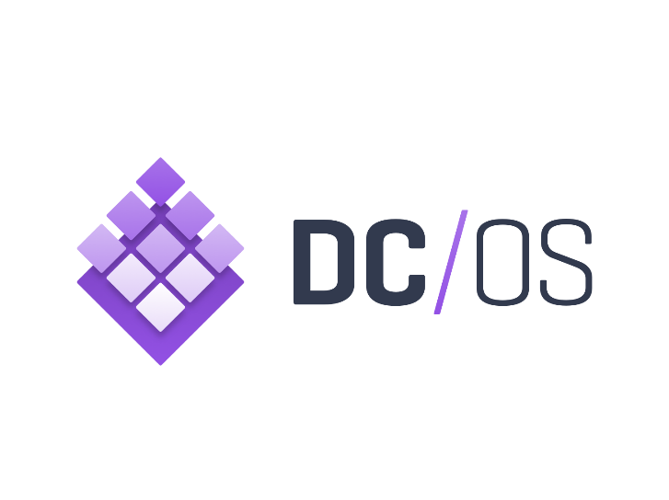

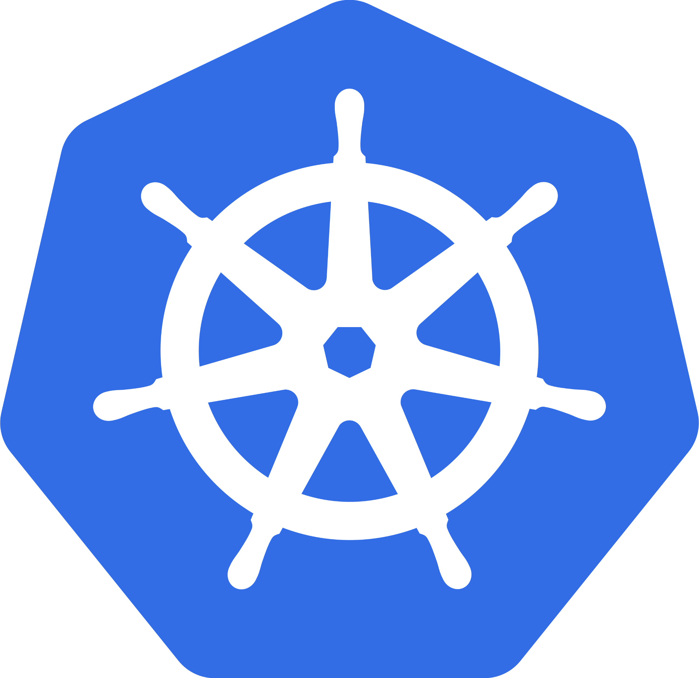
Azure Container Service
Choice of most popular container orchestrators
Simplest way to deploy open source container management platforms on Azure
Few clicks to enterprise grade container solution
<`/>
Container Registry
Container
Monitoring
DC/OS
Swarm
Command Line Interface
ARM templates
Windows &
Linux Containers
*Managed disks for
persistent storage
Kubernetes
Azure Portal
Notes:
Choice of most popular container orchestrators: Azure Container Service makes it simpler for you to create, configure, and manage a cluster of virtual machines that are preconfigured to run containerized applications. It uses an optimized configuration of popular open-source scheduling and orchestration tools. This enables you to use your existing skills, or draw upon a large and growing body of community expertise, to deploy and manage container-based applications on Microsoft Azure. Choose the tools and solution that best suits your needs for Docker container orchestration and scale operations. Use the Mesos-based DC/OS, Kubernetes, or use Docker Swarm and Compose for a pure Docker experience.
Simplest way to deploy containers on Azure: Azure Container Service provides rapid deployment of popular open-source container clustering and orchestration solutions. By using Azure Container Service, you can deploy DC/OS, Kubernetes, and Docker Swarm clusters with Azure Resource Manager templates or the Azure portal.
Few clicks to enterprise grade container solution: Azure Container Service optimizes the configuration of popular open source tools and technologies specifically for Azure. Work with the open source tools you know. Because we expose the standard API endpoints for our orchestration engine, you know the most popular tools will be compatible with Azure Container Service and, in most cases, will work out of the box—including visualizers, monitoring, continuous integration, command line tools, and even future tools as they become available.

Slide 27
App Service – container PaaS
Enterprise-grade apps
Fully managed platform
High productivity development
Global data center footprint
Hybrid support
Built-in auto scale and load balancing
High availability with auto-patching
.NET, Java, PHP, Node, and Python
Staging and deployment
AAD integrated
Secure + compliant
Reduced operations costs
Backup and recovery
Testing in production
App gallery marketplace
Notes:
- Enterprise grade apps
1. Hybrid support - Our hybrid support allows enterprises to connect back to their on-premises systems.We see a lot of scenarios where they push their web app into App Service but leave their back-end systems on-premises and connect the two.
2. Secure + Compliant- with App Service Environment, you can have a dedicated isolated environment rather than a shared multi-tenant instance of App Service.This often allows our customer base with high security policies a way to leverage this platform as a service offering.
- Fully managed plaltform
1. NoOps – we handle the underlying operating system and manage all the updates, security patching etc. You just worry about the code you run in App Service.
2.Built in auto-scale – along with not having to manage patching, we also have built in auto-scale and load balancing. We'll handle everything under the covers to handle your spikes in traffic upscaling and downscaling your app.
- High productivity development
1. Staging and deployment – we have streamlined the ability of publishing versions of your applications via deployment slots. You can very quickly switch your approved staging version to production and App Service will handle all the infrastructure actions such as DNS Host changes and so on.
2.App gallery and marketplace – along with easy deployment from Visual Studio, you can also get started quickly with various applications in the gallery marketplace.

Slide 28
Azure Service Fabric
Hyperscale microservices platform
Managed platform
High productivity development
Built-in auto scale and load balancing
High availability with auto-patching
Simple
programming models for .NET, Java
Stateful
microservices
Highly scalable
24 X 7 availability
Windows and Linux container
support
DevOps and
Lifecycle management
Health & monitoring
Available on
Private Cloud,
Public Cloud & Hosted Cloud
Learn easily using
Party clusters
Simple tooling with Visual Studio, Eclipse & Yeoman
Notes:
Hyperscale Microservices platform: Azure Service Fabric is a distributed systems platform that makes it easy to package, deploy, and manage scalable and reliable microservices.
Highly scalable: Orchestration and automation for building microservices In Fabric gives new levels of app awareness and insight to automate live-upgrades with rollback and automatic scale-up and scale-down capabilities.
24*7 availability: Azure Service Fabric was born from years of experience at Microsoft delivering mission-critical cloud services including Skype for Business, Cortana. This experience allowed us to design a platform that can deliver highly available and durable services at hyperscale.
Windows and Linux container orchestration: Service Fabric supports the following types of containers. Docker containers on Linux, Windows Server containers and Windows Hyper-V containers
DevOps and Lifecycle Management: Service Fabric provides first-class support for the full application lifecycle of cloud applications, from development through deployment, daily management, and maintenance to eventual decommissioning.
Managed Platform: Service Fabric provides first-class support for the full application lifecycle of cloud applications, from development through deployment, daily management, and maintenance to eventual decommissioning.
Built-in auto scaling and load balancing: Service Fabric Delivers low-latency performance and efficiency at massive scale, by providing automatic scale up and down capabilities.
High availability and load balancing: Service Fabric is a platform that intrinsically understands the available infrastructure resources and needs of applications, enabling an automatically updating, self-healing behavior that is essential to delivering highly available and durable services at hyperscale.
Health and Monitoring: Azure Service Fabric introduces a health model that provides rich, flexible, and extensible health evaluation and reporting. You can easily obtain health information and correct potential issues before they cascade and cause massive outages.
Available everywhere: You can run Fabric in Azure, on-premises, or in other clouds
High productivity development:
Simple programming models: Service Fabric lets developers focus on building features that add business value to their application, without the overhead of designing and writing additional code to deal with issues of reliability, scalability, or latency in the underlying infrastructure.
Stateful microservices: Service Fabric supports stateful microservices (such as user accounts, databases, devices, shopping carts, and queues) maintain a mutable, authoritative state beyond the request and its response.
Simple Tooling: Service Fabric includes Includes Visual Studio tooling, as well as command line support, so developers can quickly and easily build, test, debug, deploy, and update their Service Fabric applications on single-box, test, and production deployments.
Party Clusters: You can use Service Fabric Party clusters that are open, public Service Fabric clusters hosted on Azure and run by the Service Fabric team where anyone can deploy applications and learn about the platform. For free.

Slide 29
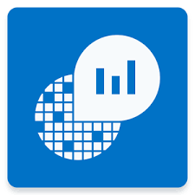
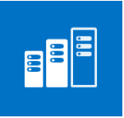



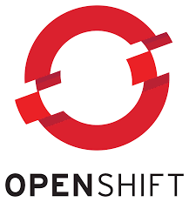
Azure Operations Management Suite
Hybrid
Container monitoring
Monitor most popular container orchestrators
Available on
Private Cloud,
Public Cloud & Hosted Cloud
Windows and Linux
Container Support
Performance
Event/Alerting
DC/OS
Swarm
Support DevOps and
Lifecycle Management
Log
Inventory
Kubernetes
OpenShift
Notes:
Containers are lightweight, pared-down virtual machines that can be easily provisioned, developers have created them sporadically as a solution to support their continuous delivery. As containers are being used widely in production and are exploding in numbers, demand for container monitoring has increased. A centralized approach to logging and monitoring is required. OMS Container Solution helps with these needs.
See information about all container hosts in a single location
Know which containers are running, what image they’re running, and where they’re running
See an audit trail for actions on containers
Troubleshoot by viewing and searching centralized logs without remoting to the Docker hosts
Find containers that may be “noisy neighbors” and consuming excess resources on a host
View centralized CPU, memory, storage, and network usage and performance information for containers

Slide 30

Thank You!
www.Microsoft.com/containers
@docker
#dockercon

